Slide 1
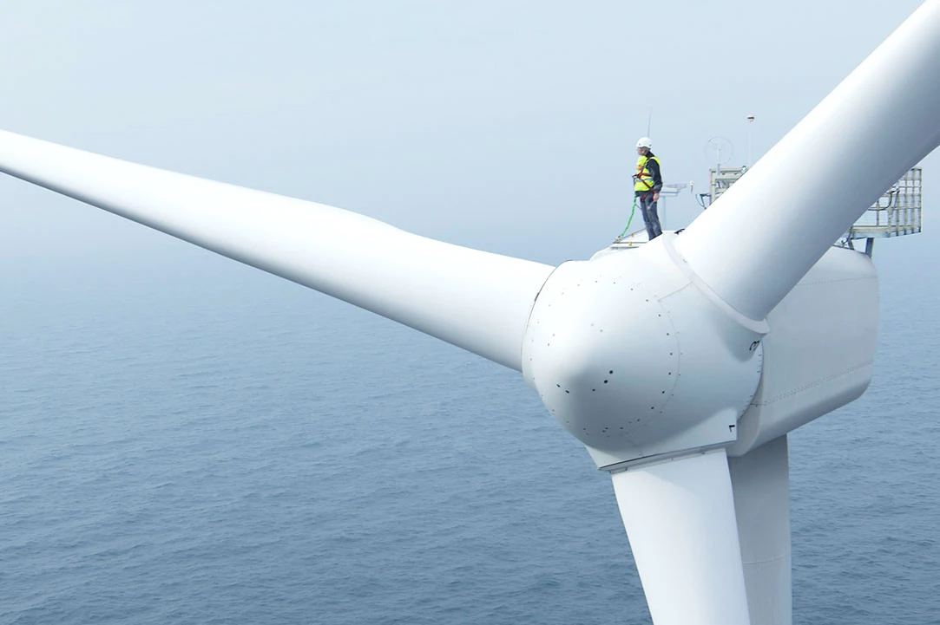
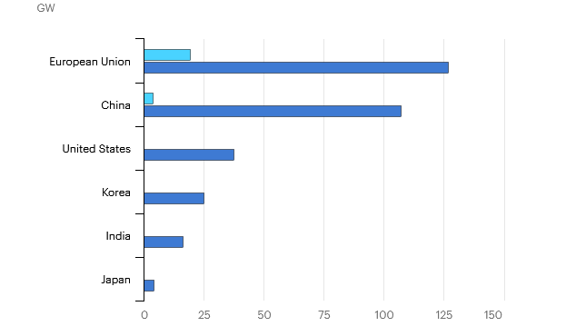
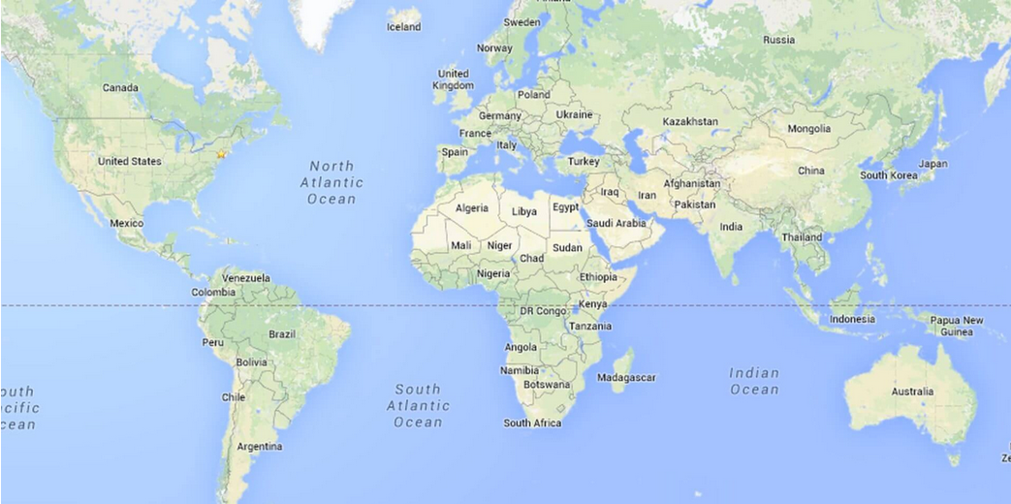

INTRODUCTION
Industry outlook
Offshore wind farm projets are set to increase around the world in coming years according to factors such as:
Wind speed, Distance to shore, Water Depth
Flora, fauna, human activities
Our team aims to develop a tool to help industry leaders to take informed decisions regarding the location of the sites

